Slide 1
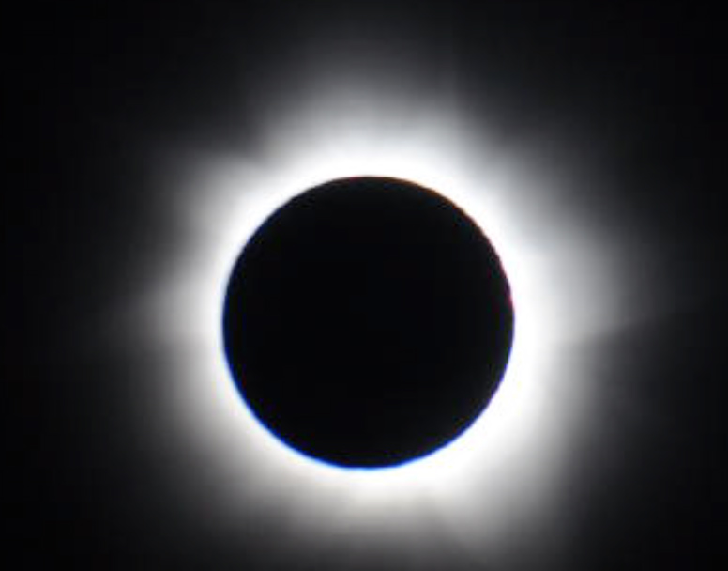
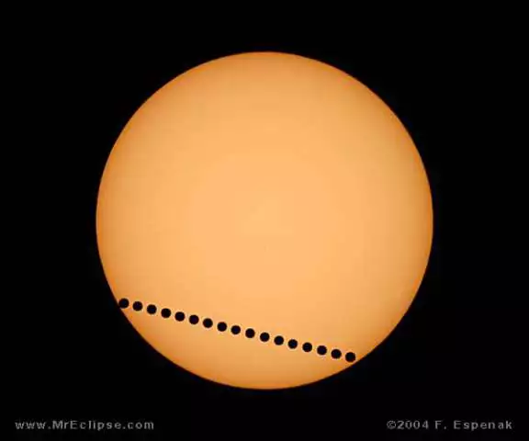
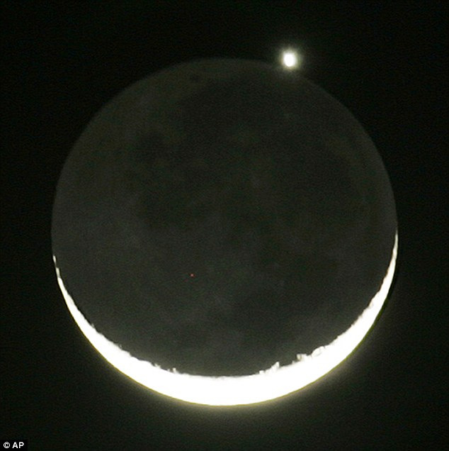
Lec 13: Transits
© Gerard Williger 2023, U Louisville
Eclipse: one body passes in front of another and ALMOST or JUST completely covers it
From Ancient Greek ékleipsis
Ekleípō, “I abandon, go missing, vanish”
Ek, “out”
Transit: When one object passes in front of another but is TOO SMALL to cover (eclipse) it
Mercury or Venus in front of Sun
Other moons e.g. Phobos in front of Sun from Mars, Ganymede in front of Jupiter from Earth
Occultation: When one objects passes in front of another and is BIGGER in angle than the background object
Moon passes in front of an asteroid/planet
Asteroid/planet passes in front of a star
No clear threshold between “shallow annular eclipse” and “transit by a big object”, or “big eclipse” and “occultation”
Time lapse, 2004 Venus transit, F Espenak
Moon occults Venus, LINK
Notes:
Black object is foreground and moving faster (in angular speed) than blue background object.
Foreground object is typically something in our solar system (planet, asteroid, Moon etc.)
Background object can be anything, including a star or nebula.

Slide 2
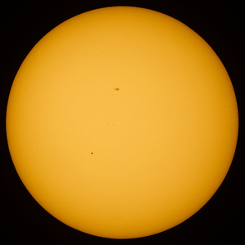
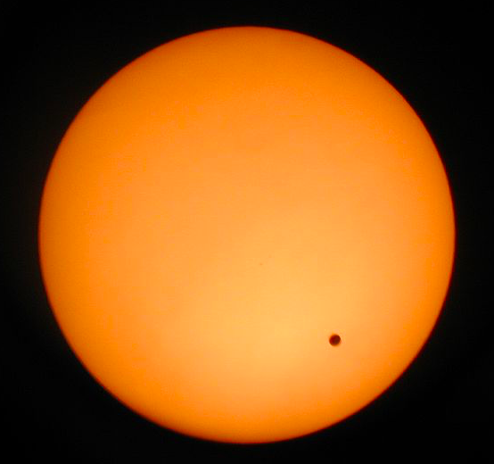
Transits of Mercury, Venus
© Gerard Williger 2023, U Louisville
Hard to observe:
RARE: 13-14x/century (Mercury), 2x/century (Venus)
Only last 6-8 hours maximum
¼ of Earth sees full transit; 60-70% see parts
Hard to see either planet against bright disk of Sun – need telescope for Mercury (1/225th size of Sun’s disk)!
Venus only 1/60th size of Sun’s disk
Mercury transit, May 9, 2016, Elijah Mathews, East Grand Forks MN (Wikipedia)
Venus transit, June 4, 2004, Degania A, Israel (Wikipedia)
sunspot
Mercury
Venus

Slide 3
Review: Distances in Astronomy
© Gerard Williger 2023, U Louisville
Only see ANGLES on sky
Kepler’s & Newton’s Laws → RELATIVE DISTANCES in Solar System
Need TRUE DISTANCES to know SIZES, SPEEDS of objects
Newton’s Laws → MASSES of objects if they have objects orbiting them
Planets orbit Sun ; moons orbit planets
MASSES & SIZES → DENSITIES
→ compositions: gas, ice, rock, iron etc.

Slide 4
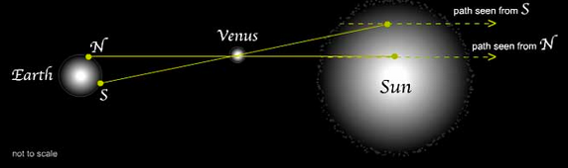
Usefulness of Transits
© Gerard Williger 2023, U Louisville
Work out absolute size of solar system
METHOD proposed by Edmond Halley, 1716
More science later
NOT TO SCALE
Image: exploratorium.edu
Must time transit precisely + measure small angles!
Difference in angle from N, S poles on Earth for
Venus transit: 1 arcmin (1/30th angle change on Sun’s disk)
Mercury transit: 0.5 arcmin (1/60th angle change on Sun’s disk)
Notes:
Basketball: 9.5 inch = 24 cm diameter.
Using Venus for parallax (triangulation) is hard! Using Mercury EVEN HARDER! **CONSIDER SPLITTING THIS SLIDE INTO TWO**

Slide 5

Inner Planet Orbits to Scale
© Gerard Williger 2023, U Louisville
Distances are to scale for Sun’s size
Earth (110x smaller than Sun)
Venus (115x smaller than Sun)
Mercury (285x smaller than Sun)
Sun
Range of Earth’s orbit (eccentricity e=0.017)
Venus has a nearly circular orbit (e=0.007)
Range of Mercury’s very elliptical orbit (e=0.21)
If Sun were basketball, then:
-- Mercury is 0.7mm poppy seed, 42 solar diameters (11 yds = 10 m from Sun)
-- Venus is 2mm peppercorn, 78 solar diameters (20 yds = 18.7 m from Sun)
-- Earth is 2mm peppercorn, 108 solar diameters (29 yds = 26 m from Sun)
Notes:
Basketball: 9.5 inch = 24 cm diameter.
Using Venus for parallax (triangulation) is hard! Using Mercury EVEN HARDER! **CONSIDER SPLITTING THIS SLIDE INTO TWO**

Slide 6
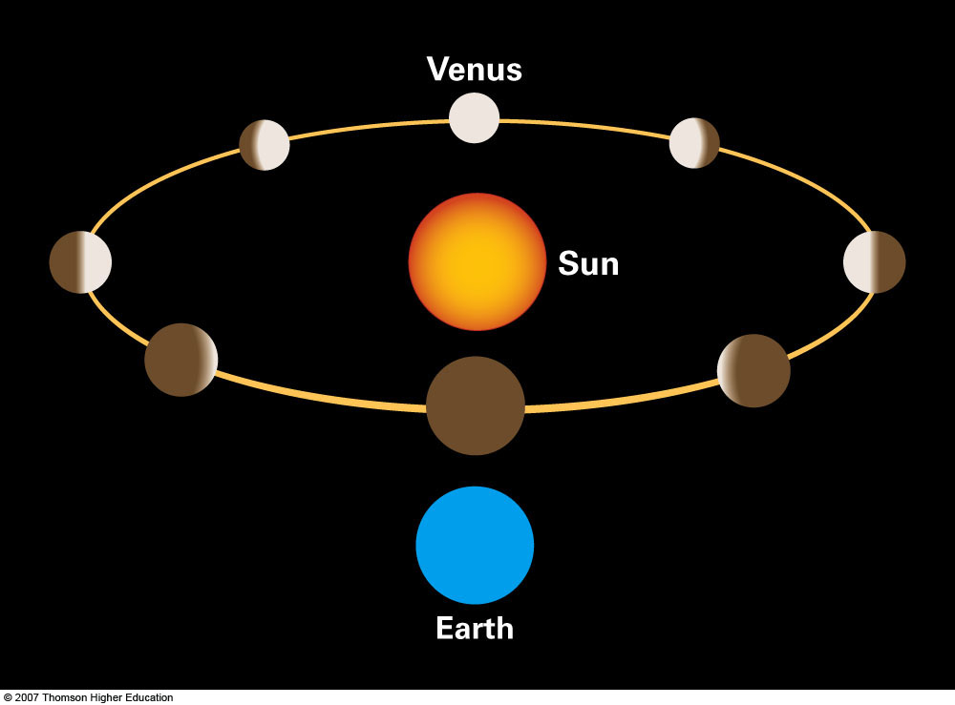
Venus Orbit (Mercury is similar)
“Full”
When Transits Happen: Conjunction
“Superior” Conjunction (behind Sun)
“New Venus”
Transit
“Inferior” Conjunction
Perspective: explains phases/sizes of Venus: full/small when far away, crescent/big when near
© Gerard Williger 2023, U Louisville
Image credit: Pasachoff & Filippenko 2019, Ch. 5 Fig.
Notes:
Pasachoff & Filippenko, Figure 5.20: When Venus is on the far side of the Sun as seen from the Earth, it is more than half illuminated. We thus see it go through a whole cycle of phases, from thin crescent (or even “new”) through full. Venus thus matches the predictions of the Copernican system.
Either conjunction is called a “syzygy” (3 bodies lined up)

Slide 7
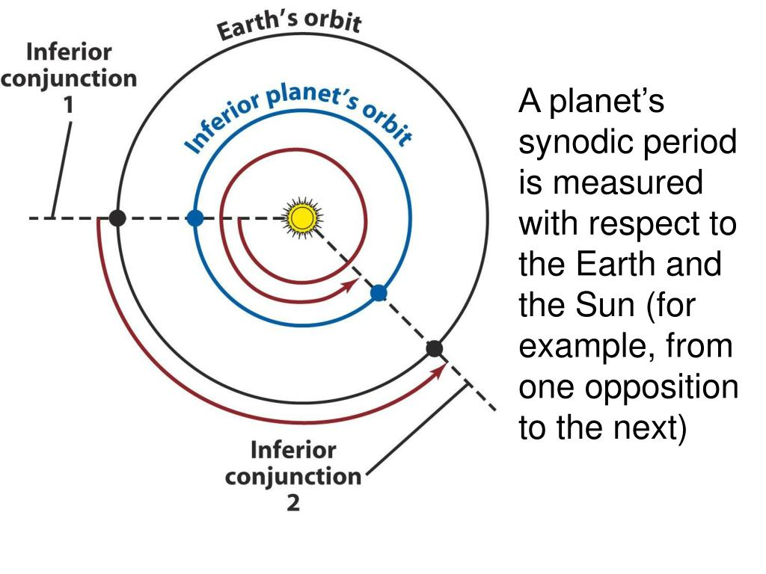
When Conjunctions Happen
© Gerard Williger 2023, U Louisville
Happens once each “synodic period”
time to come to same relative Earth-planet-Sun position
Example: between inferior conjunctions
Time taken for inner (“inferior”) planet to “lap” Earth
(Mercury’s)
Source: slideserve.com
Mercury: orbital period = 88 days, synodic period with Earth = 116 days
1.32 Mercury “years”
0.32 Earth years
Venus: orbital period = 225 days,
synodic period with Earth = 584 days
2.60 Venus “years”
1.60 Earth years

Slide 8
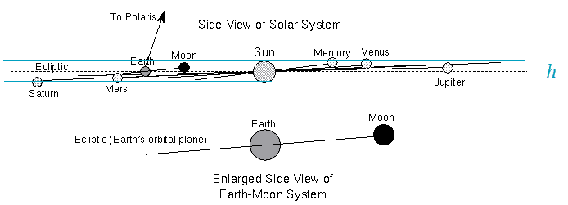
Why Transits are RARE - I
© Gerard Williger 2023, U Louisville
Mercury, Venus orbits INCLINED to Earth’s!
Mercury: 7.01 degrees
Venus: 3.39 degrees
Source:
stackexchange.com
Most of time, WHEN Mercury or Venus are at inferior conjunction
→ pass ABOVE or BELOW Sun – SAME reason solar eclipses are rare!
Notes:
Remember 10 degrees is one fist width at arm’s length.

Slide 9
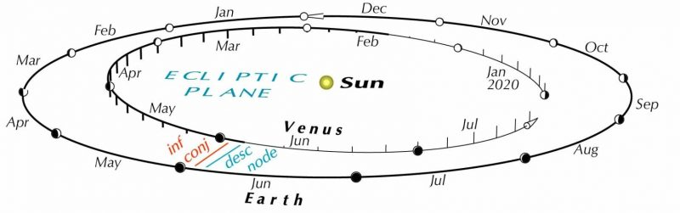
Why Transits are RARE - II
© Gerard Williger 2023, U Louisville
Planet must be at inferior conjunction AND close to LINE OF NODES
Mercury:
Must be within about 1.5 days of crossing line of nodes, near May 8 or Nov 10 (3.5% of time)
Venus:
Must be within about 2.1 days of crossing line of nodes (3.8% of time)
Ascen node
Line of nodes
Transits here
Example for Venus;
Mercury is similar
Image credit: Guy Ottewell, in Sky & Telescope, LINK
Note: Mercury and Venus move faster than Earth, so transits are left to right in the N hemisphere
Dates of crossing line of nodes vary slowly over time
Notes:
Dates of crossing line of nodes vary slowly due to Earth’s precession, the synodic period not being an integral number of days etc.
Note: line of nodes for Earth-Venus system precesses every 70,000 years (Barnes, Quarles, Lissauer et al. 2016 Jan 29, DO=10.1089/ast.2015.1427 Astrobiology, 16,

Slide 10
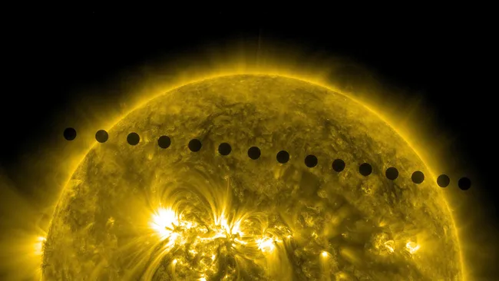
Why Transits are RARE - III
© Gerard Williger 2023, U Louisville
Applying both conditions (inferior conjunction and line of nodes), we have:
Mercury Transits:
Conjunctions every 3.9 months, about every 7-8 conjunctions has a transit
13-14 transits/century
range between 3 and 13 years apart, due to Mercury’s elliptical orbit AND its “advancement of perihelion” (effect of Einstein’s general relativity)
Venus Transits:
Conjunctions every 19.5 months, on average every 40 conjunctions has a transit
2 transits about every 120 years, in pairs 8 years (5 conjunctions) apart, at least during 1386 – 3089 AD
Each pair is either in June (descending node) or December (ascending node)
One of the pair will be on the south side of the Sun, and the other will be in the north
Venus transit montage, June 8, 2004, by Fred Espenak, mreclipse.com (north is up)
Venus transit montage, June 5, 2012, by NASA’s Solar Dynamics Observatory satellite (north is up) LINK
Notes:
Orbit of Mercury is not quite a closed loop due to general relativity)

Slide 11
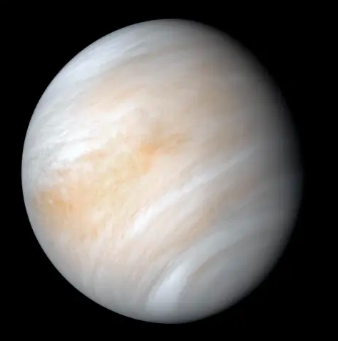
Science from Transits
© Gerard Williger 2023, U Louisville
Transit provides:
1) Precisely timed observation of Mercury, Venus
2) Precise direction
3) Bright light (Sun!) behind the planet
What we can LEARN (LINK):
1) Distance to planet (via triangulation)
---------- Use Kepler’s and Newton’s Laws → distance to Sun
2) Variability of Earth’s rotation → measure acceleration of Moon
3) Measuring Venus’ gravitational pull on Mercury → mass of Venus
4) Limit variations of solar diameter over time (since 1631)
5) Study any atmosphere on Mercury or Venus
6) Test methods used to observe planets transiting other stars
Venus, Mariner 10, NASA LINK

Slide 12
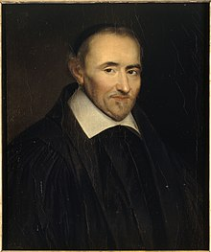
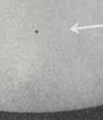
Early Mercury Transit Observations
© Gerard Williger 2023, U Louisville
Predicted for Nov. 7, 1631 by Kepler in tables of planet positions, 1630
Kepler died Nov 15, 1630
Observed by Fr. Pierre Gassendi (priest+scientist)
Surprised by Mercury’s small size LINK
10-12 arcsec size → poppyseed at 10-20 meters (yards)
Mercury hard to observe at twilight – close to Sun!
-- Nov 7, 1677, Edmond Halley (St Helena) + Richard Towneley (Lancashire, England) to triangulate Sun’s distance, suspected inaccurate (was 50% too small)
-- Nov 9-10, 1769, Capt. Cook & Charles Green, New Zealand – noted no atmosphere for Mercury
-- May 5, 1832, Priestley + Weale, Greenwich, England, measured diameter of Mercury
-- also Bessel + Argelander, Prussia-Finland – both teams noticed “merging of planet with solar limb (edge)”
Gassendi (1592-1655), by Louis-Édouard Rioult, c. 1846-47
Photo, transit Nov. 7, 1914, Greenwich, England, courtesy Laurence Marshall LINK
Notes:
Tables of planet positions called ephemerides

Slide 13
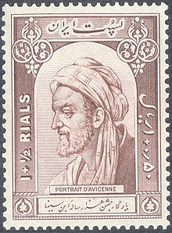
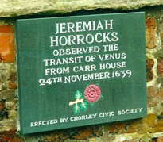
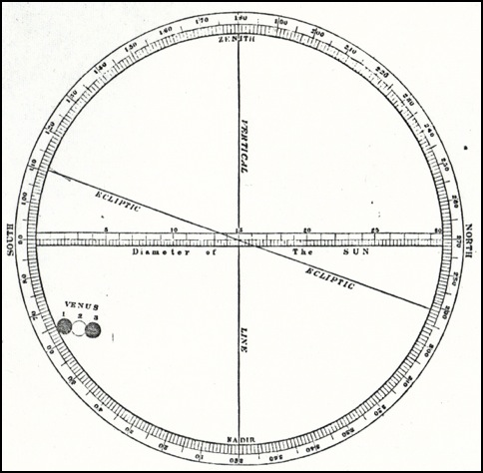
First Venus Transit Observations
© Gerard Williger 2023, U Louisville
Persian polymath Avicenna (980-1037) claimed to have seen Venus as a spot on the sun
Possible for May 24, 1032, but he did not give a date
May have been a sunspot LINK
Predicted by Kepler 1627 for 1631, also for 1761 (but not 1639) LINK
Calculation refined by Jeremy Horrocks (clergyman+astronomer), predicted + observed with Wm. Crabtree, Dec. 4, 1639, Preston and Broughton, northern England
Horrocks estimated size of Venus
Calculated distance to Sun (2/3 of actual value, best to date)
Avicenna, Iranian stamp, 1950
Memorial plaque, LINK
Horrocks’ drawing, source LINK
Notes:
Kepler’s prediction for 1631 was not accurate enough to say that the transit was not visible from much of Europe, just from
Germany and Austria to the east. Horrocks observed the 1639 transit in projection.

Slide 14
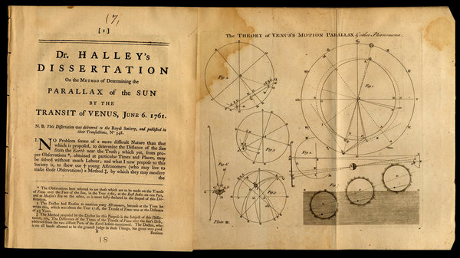
Venus Expeditions: June 6, 1761
© Gerard Williger 2023, U Louisville
Halley (1691, 1716) proposed Venus transits as more accurate for calculating distance to Sun LINK
Died 1742
1761 British, French competition, other countries also involved, to send observing expeditions
Diagram from Halley’s 1678 dissertation on calculating distance to Sun using June 4, 1761 transit of Venus. Slide from NY times. Source LINK
Much success for observations in: Siberia, Newfoundland, Madagascar, South Africa (Jeremiah Dixon & Charles Mason), St. Petersburg (Mikhail Lomonosov)
French organizer: Joseph-Nicolas Delisle
Notes:
Maxon & Dixon also charted the state line between Pennsylvania and Maryland, 1763-67!

Slide 15
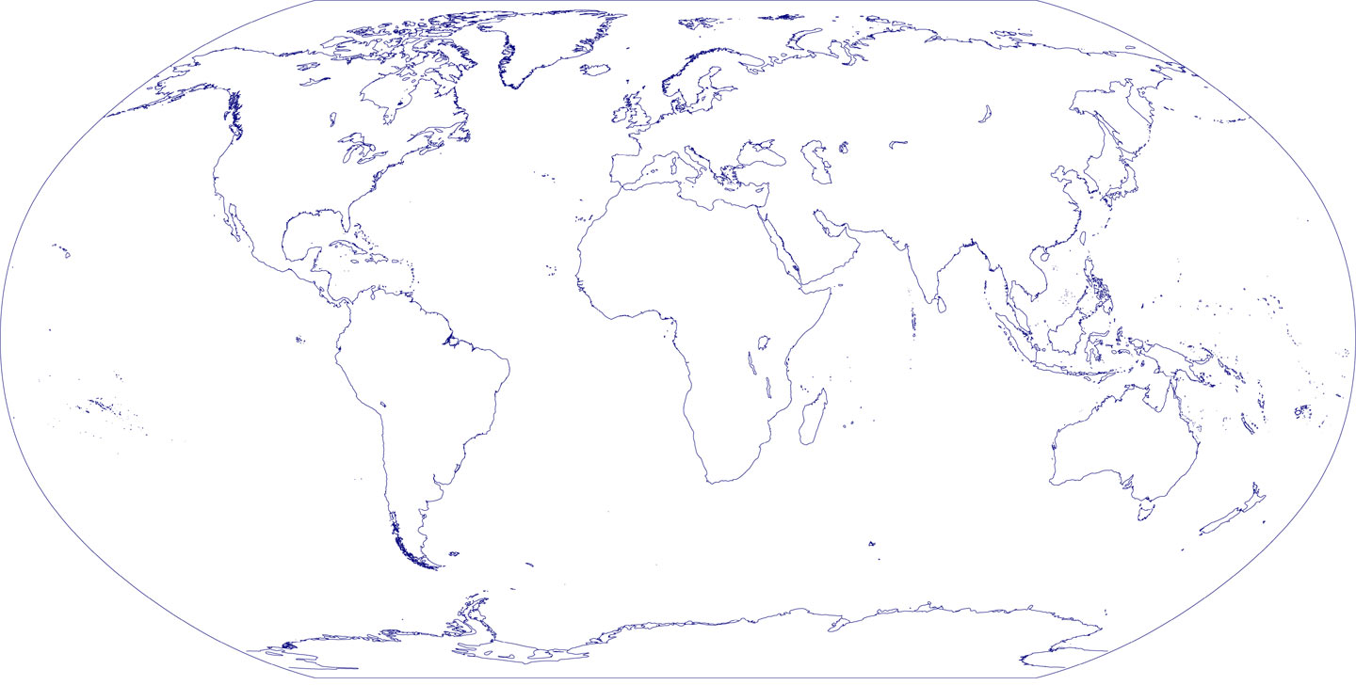
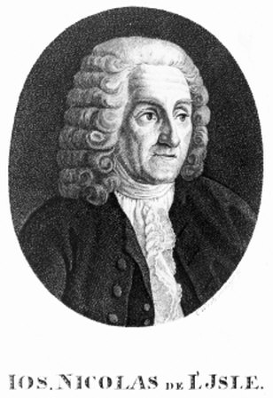
European astronomers coordinated expeditions to view the transit of 1761 (7 Years’ War!)
Hell
Chappe
Winthrop
Thury
Le Gentil
Maskelyne
Pingré
Dixon & Mason
British
French
Austrian
Slide courtesy of Rick Pogge, Ohio State Univ.
Notes:
2023.11.22 - Credit changed from Barbara Ryden
Maximilian Hell (German for “bright”) was a Jesuit astronomer and director of the Vienna Observatory.
The lunar crater Hell is named after him.

Slide 16
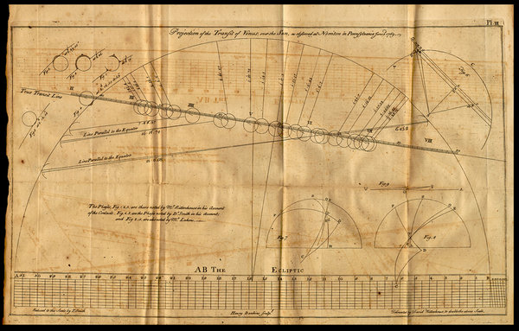
Venus Expeditions, June 3-4, 1769
© Gerard Williger 2023, U Louisville
More expeditions:
Tahiti (Cook & Greene), St. Petersburg + 8 other places in Russian Empire, London, Norway, Hudson Bay, various parts of future US + Canada, Baja California (20/28 in expedition died)
Sponsored by Catherine the Great, George III, Christian VII of Denmark, Pennsylvania legislature etc.
Distance to Sun calculated to 3% of current value
Drawings from David Rittenhouse, Pennsylvania (slide from NY Times)
Atmosphere of Venus detected by several teams
Notes:
Baja California expedition succumbed to Yellow Fever

Slide 17
1769 transit: War’s over, back to science!
Hell
Wales
Winthrop
Chappe
Le Gentil
Cook
British
French
Austrian
Slide courtesy of Rick Pogge, Ohio State Univ.
Notes:
2023.11.22 - Credit changed from Barbara Ryden

Slide 18
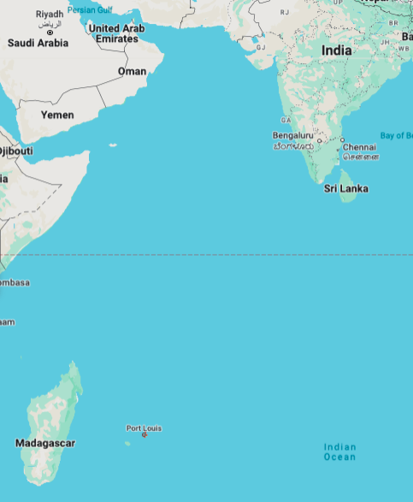
Unluckiest Astronomer: Guillaume Le Gentil (1725-92)
© Gerard Williger 2023, U Louisville
Left France Mar 1760 to Pondicherry, India to observe June 6, 1761 eclipse
Seven Years War got him stuck in Mauritius
Mar 1761 got on ship to India BUT British occupied city
Spent transit at sea, saw but couldn’t measure timings from pitching ship
Stayed for June 3-4, 1769 eclipse
Explored Madagascar, set off for Philippines
Spanish refused entry, returned to India (again French), Mar 1768
Built observatory, TRANSIT CLOUDED OUT
Caught dysentery enroute home, stormy weather, marooned on Réunion Is.
Pondicherry
x
Google Maps
Mauritius
x
x
Reunion

Slide 19
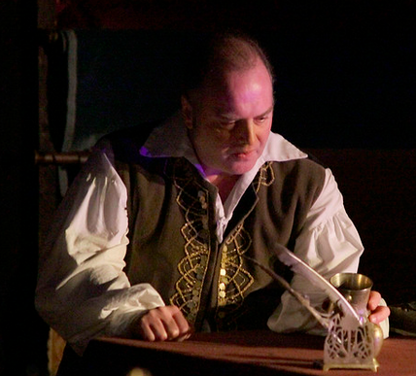
Unluckiest Astronomer- II
© Gerard Williger 2023, U Louisville
Le Gentil – finally back to Paris, Oct. 1771
None of his letters got back to France due to shipwrecks, wartime attacks on ships
Declared dead
Lost seat in Roy. Acad. Of Sciences
Relatives plundered estate
“Lengthy litigation and … intervention of the king were ultimately required before [regaining his seat in Royal Academy of Sciences and remarrying]”
Despite bad luck: much good general science done during travels (source LINK)
Transit of Venus, play by Maureen Hunter 1992, opera by Victor Davies, performed 2007, 2010
Transit of Venus play, Nov 7, 2013, U Central Lancashire, UK
Notes:
Le Gentil ended up re-marrying with a wealthy heiress and had a daughter, on whom he doted. Sheehan June 2004, Sky & Telescope

Slide 20
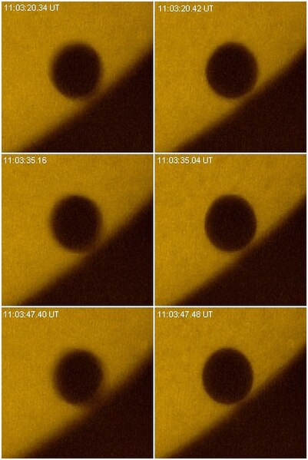
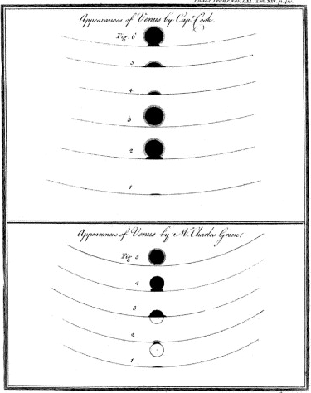
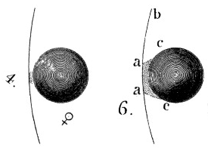
Black Drop Effect – A Puzzle
© Gerard Williger 2023, U Louisville
Smearing of Venus (and Mercury) with Sun’s edge
Adds UNCERTAINTY to transit timing
Many suggested causes, including
Venus’ atmosphere to
local effects in Earth’s atmosphere
BUT
also seen with Mercury (NO atmosphere!)
From Torbern Bergman, 1761, via Schneider+ 2004, Icarus, 168, 249, from the Royal Society
From Cook & Green, 1769 (published 1771), via Schneider+ 2004, Icarus, 168, 249, from the Royal Society
From H. Raab, Linz, Austria, 2004, over 14 second time span for “good” and “bad” atmospheric conditions (“seeing”) LINK

Slide 21
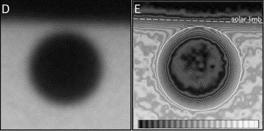
Black Drop Effect - Explanation
© Gerard Williger 2023, U Louisville
Observations of Mercury transit, Nov 11, 1999 by NASA’s TRACE satellite show effect!
Cause is
1) Inherent blurriness of diffraction through telescope (“Point Spread Function”) and
2) Sun’s edge is dimmer than middle (“limb darkening”)
3) Atmospheric turbulence makes it worse
Black drop effect
Highly processed image by Schneider, Pasachoff & Golub (2004) showing direct view (left) and contour plot of light level (right).

Slide 22
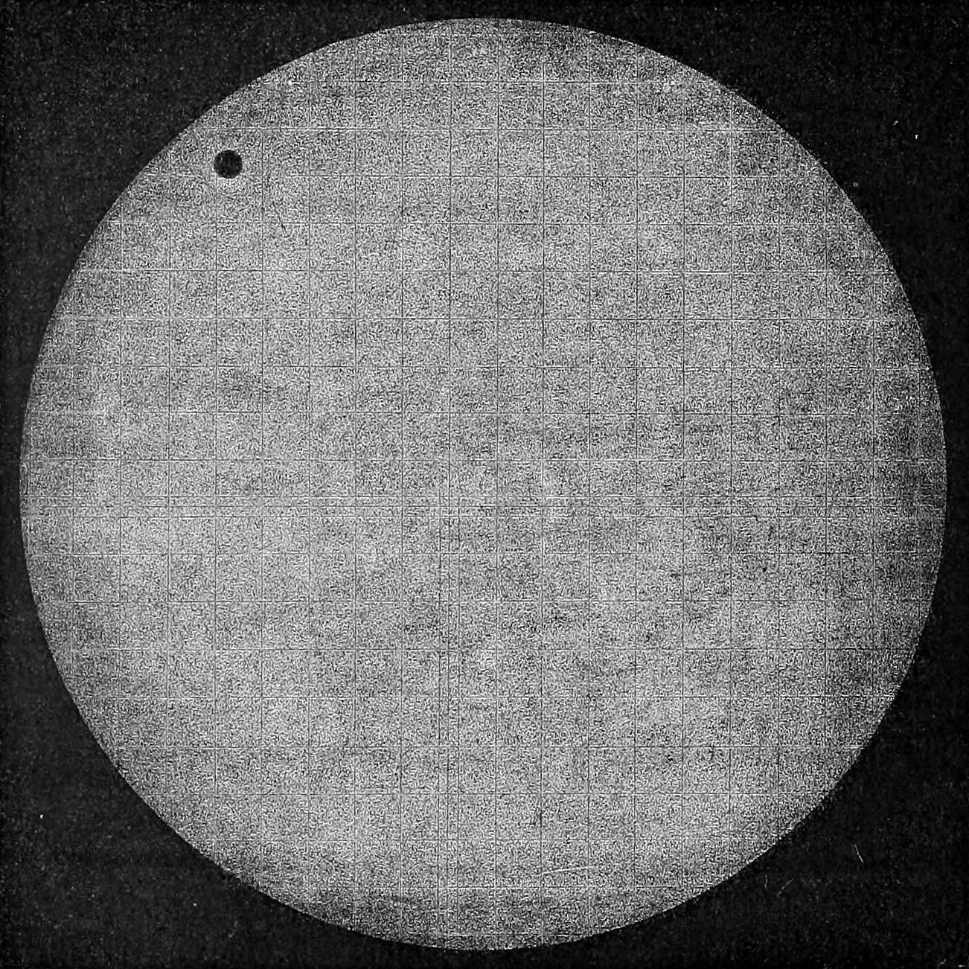
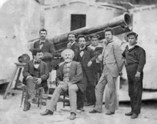
Dec 9, 1874 Venus Transit
© Gerard Williger 2023, U Louisville
visible from E Asia, Australia/NZ, South Indian Ocean
Expeditions:
France (6), Britain (5), US (8 -- funded by Congress, Commission Secretary Simon Newcomb); see Meadows 1974, Nature, 250
1st photos: 350 photographic plates
1st “movie” (Jules Janssen, oldest in IMDB!)
No better accuracy than 1761/69!
Other methods used for distances with increasing accuracy:
Parallax (triangulation) of Mars LINK
Speed of light, deflection effect from Earth’s orbital motion (“aberration of starlight”) – S. Newcomb
Photo, J. Janssen team, Japan LINK
Janssen team LINK

Slide 23
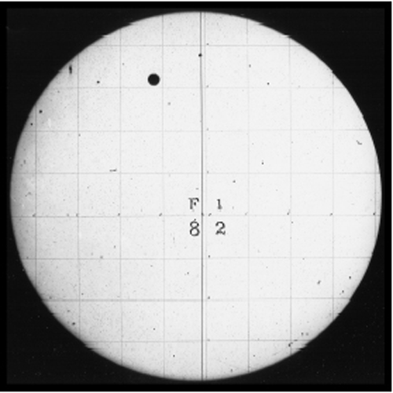
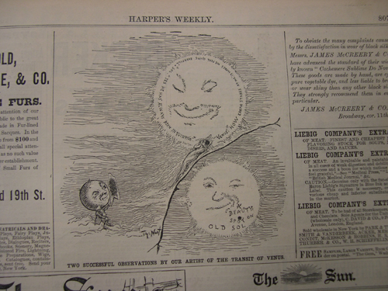
Dec 6, 1882 Venus Transit
© Gerard Williger 2023, U Louisville
Completely visible to S America, eastern N America; partially visible in Europe, Africa, Pacific
Less scientifically useful, but many governments still sent expeditions worldwide
NY Times criticized expense LINK
Public could observe it through smoked glass (or projection) – “shared human event”
1882 transit, US Naval Observatory source LINK
Illustrated London News/Harper’s Weekly, Dec. 1882, source LINK
Notes:
Most original plates of the 1882 transit have been lost.

Slide 24
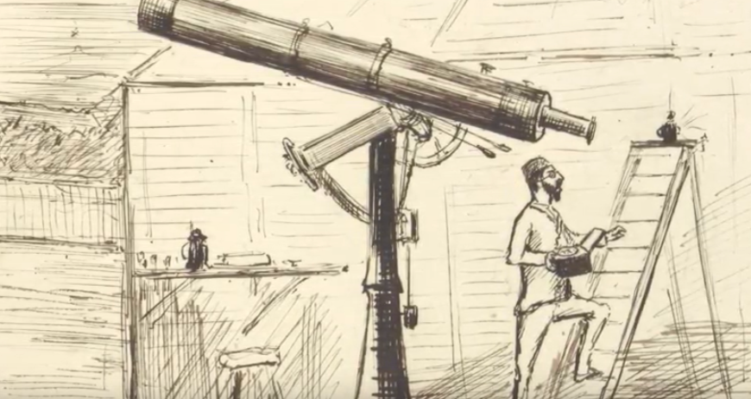
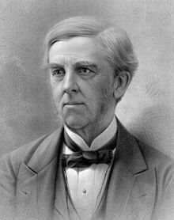
1874, 1882 Transits in Pop Culture
© Gerard Williger 2023, U Louisville
Poem, Punch, Dec. 19, 1874: LINK
The Transit of Venus is over:
A spot on the Sun for four hours,
The radiant arial-rover
Now sparkers the chief of star-flowers,
Home troop the astronomers various
And bring their celestial log… [goes on]
Transit of Venus 1874, book by Henry Chamberlain Russell
Oliver Wendell Holmes, 1882, The Flâneur: LINK
…The sun and I are face to face;
He glares at me, I stare at him;
And lo! My straining eye has found
A little spot that, black and round, …
[Also reflected in his autobiography LINK]
“… saw the transit of Venus, my whole idea of the creation has been singularly changed…”
Sousa march
Sousa novel
FYI 5.7’ VIDEO,1874 British expedition to Hawaii
Holmes c. 1879, source LINK
Notes:
Both transits were covered in the popular press, both for scientific promise and the expenses paid for expeditions to observe them. The 1874 transit marked
the birth of astronomy in New Zealand. Holmes paid 10 cents to look through a telescope at the transit and it changed his life. Frâneur = stroller

Slide 25
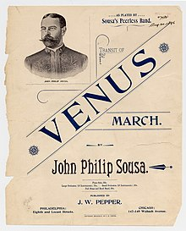
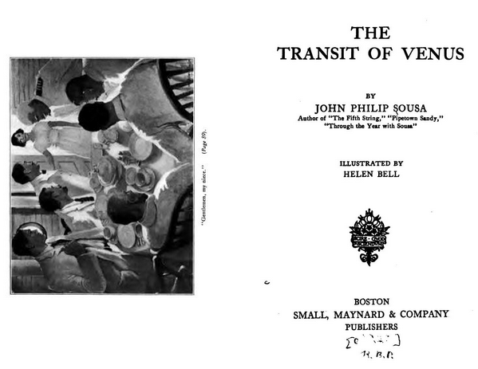
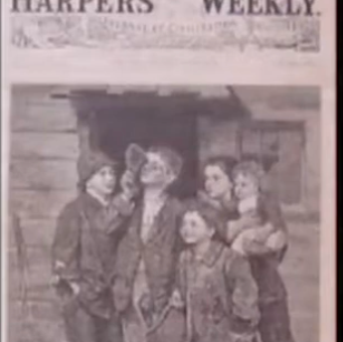
1882 Transit in Pop Culture
© Gerard Williger 2023, U Louisville
Transit of Venus March, John Philip Sousa, 2.2’ AUDIO
Novel, The Transit of Venus, J.P. Sousa, 1920, LINK
1896, Publisher: J.W. Pepper Co., Source LINK
FYI 49’ VIDEO, David DeVorkin, Nat’l Air & Space Museum, Public Reaction to the Transit of Venus 1882
Notes:
The 1874 and 1882 transits were extensively covered by the media, even though scientifically they turned out not to be so valuable.

Slide 26
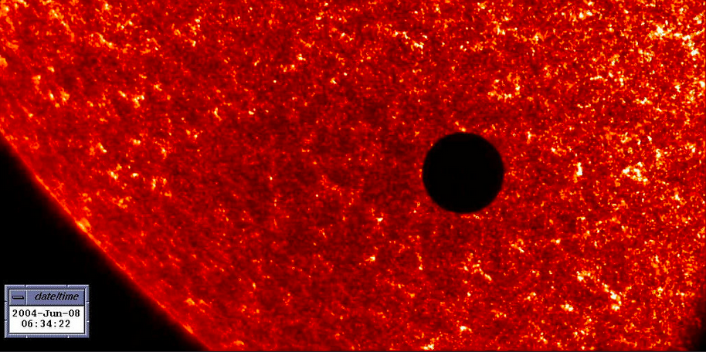
June 8, 2004 Venus Transit
© Gerard Williger 2023, U Louisville
Visible in Asia, Europe, Africa; partially in N & S America, Australia LINK
European Southern Obs. organized 2700 amateur observers to re-measure Astronomical Unit (dist. to Sun)
Got to 0.007% of current value
Broadcast extensively, observed in space
NASA’s TRACE satellite (Transition Region and Coronal Explorer), June 8, 2004, UV (ultraviolet) wavelengths. Note Venus is about the same size as Earth. Source LINK
Time series, June 8, 2004, Fred Espenak, 30 minute intervals, Vixen 8cm Fluorite refracting telescope, Sounion, Greece
Note: Venus blocks 0.008% of Sun’s area (light) – slight but measurable

Slide 27
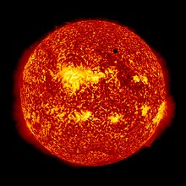
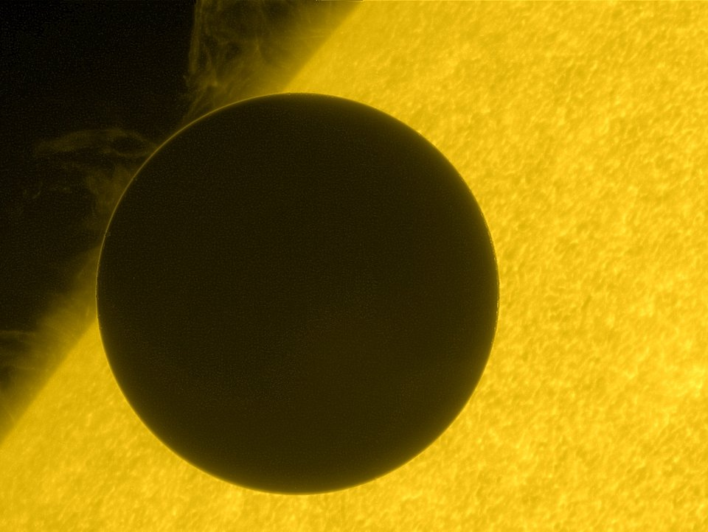
June 5-6, 2012 Venus Transit
© Gerard Williger 2023, U Louisville
Visible in E Asia, E Australia, Pacific; partially in N America, W Asia, Cent. Europe, E Africa
Widely broadcast, LINK
Science measurements:
Dip in Sun’s light output when it had many sunspots – useful for exoplanet transits
Exoplanet = planet around another star
Diameter of Venus, compared to known value, to calibrate exoplanet observations
Sunlight through Venus’ atmosphere, to compare with exoplanet observations
Included some simultaneous data from Venus Express orbiter
Tested possible atmosphere detection technique from 1761 with similar telescopes
UV image from NASA’s Solar Dynamics Observatory
UV image from Hinode, joint JAXA (Japan)/NASA/UK mission. Note atmospheric glow.

Slide 28
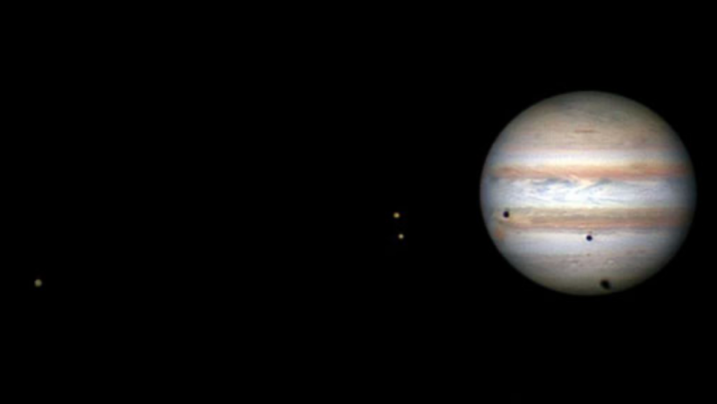
Transits/Eclipses: Jupiter’s Moons
© Gerard Williger 2023, U Louisville
4 giant moons discovered by Galileo, 1610
Sizes from 90% of Earth’s Moon to >Mercury
Periods 2-17 days
Transits: pass in front of Jupiter
Eclipses: pass in/out of Jupiter’s shadow
Callisto’s shadow
Io
Callisto
Europa
Triple transit of Callisto, Io, Europa on Oct 11-12, 2013. Image by John Sussenbach (Netherlands). Note shadows on Jupiter’s sphere. From earthsky.org LINK via Sky & Telescope.
Transits visible in large binoculars or 2-3 inch (5-7 cm) diameter telescope

Slide 29
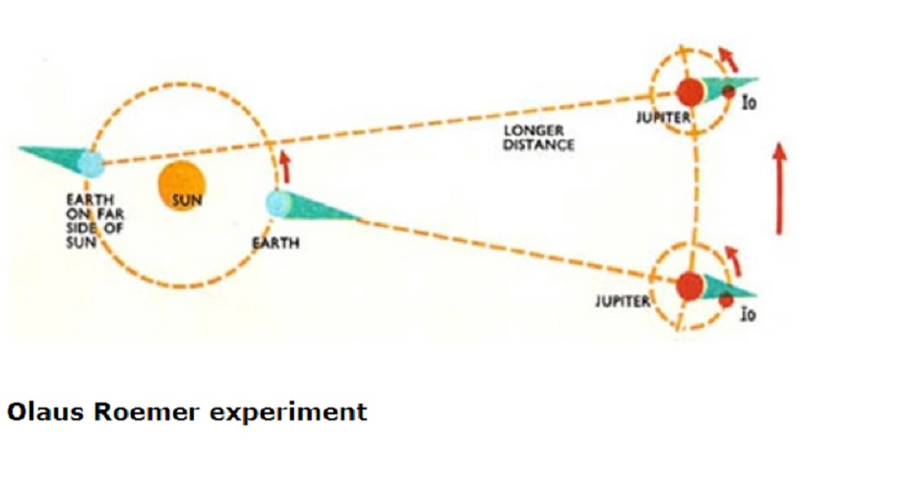
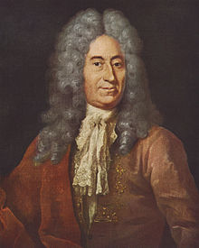
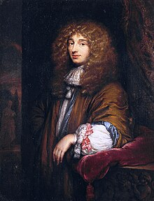
Jupiter Satellite Eclipses = Clocks
© Gerard Williger 2023, U Louisville
Jupiter and Io approximately to scale for size, distance. Others up to 50% bigger.
Europa → 1.6x farther
Ganymede → 2.5x
Callisto → 4.5x
Jupiter
Io
Orbits are regular → eclipses predictable, frequent
Common belief: speed of light was infinite!
1676: Ole Rømer (Denmark) noticed Io’s eclipses were late when Jupiter was farther away
1678: Christiaan Huygens (Netherlands) then calculated speed of light to be about 2/3 of its current value
Louis XIV team: Alexander Mackenzie & Zebulon Pike mapped using Jupiter satellite timing, 1700-1810
Rømer (L) and Huygens (R), source LINK1 LINK2
Notes:
Louis XIV team included Giovanni Cassini & Jean Picard to map France. Mackenzie mapped W Canada. Pike mapped W US (Louisiana Purchase).
Europa similar size to Io.

Slide 30
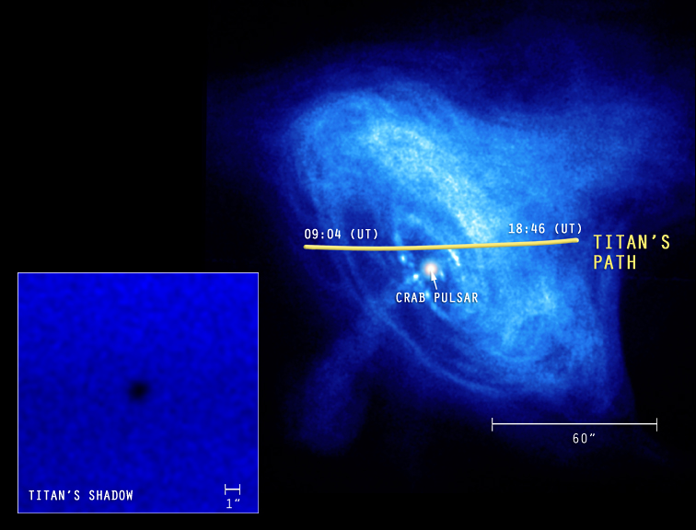
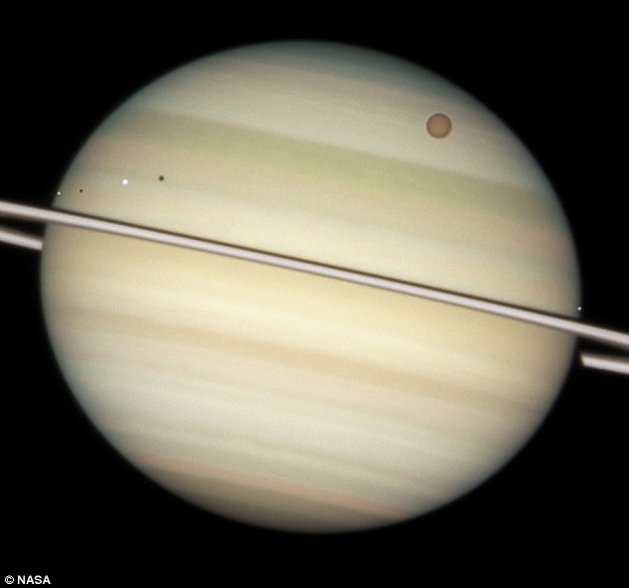
Transits of Titan
© Gerard Williger 2023, U Louisville
Giant Moon of Saturn, bigger than Mercury, orbits 10 Saturn diameters away, period = 15 days
Titan: appears size of dime at 2.5 miles
Titan making rare transit of Crab Nebula (remnant of supernova from 1054), observed by Chandra X-Ray Observatory (NASA), Jan 5, 2003. X-rays from nebula probed Titan’s atmosphere. Next transit: 2267. Source LINK
Quadruple transit of Titan + 3 smaller moons (Mimas, Dione, Enceladus), Mar 17, 2009, from Hubble Space Telescope (NASA/ESA), via Daily Mail LINK

Slide 31
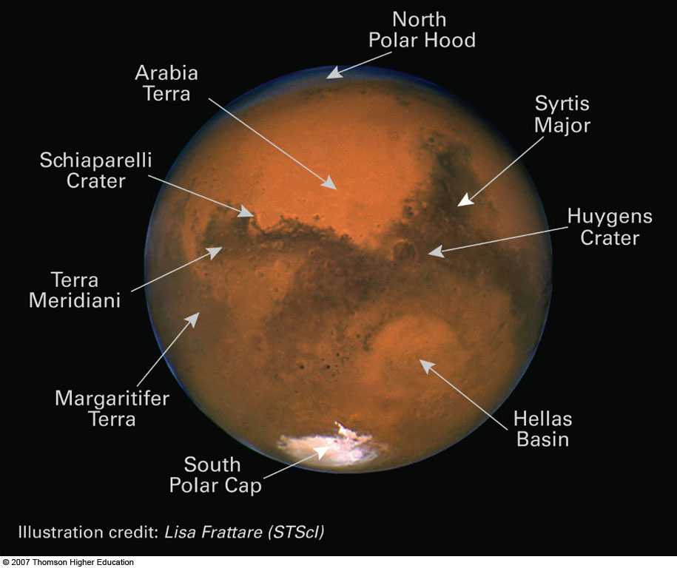
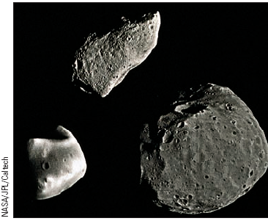
Mars
FYI 3’ intro video
diameter 6775km (~50% of Earth/Venus)
2 TINY moons: Phobos, Deimos
Orbit within 1.1 degrees of equator
"DAY" ~24½ Earth hours, like Earth’s
Axis tilt 25° → SEASONS like Earth’s
Thin CO₂ atmosphere, pressure 1% Earth’s
Surface red from iron oxides; has dust storms
3390km
Asteroid Gaspra
Deimos
10km
Phobos
© Gerard Williger 2023, U Louisville

Slide 32
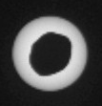
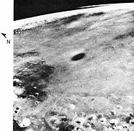
Transits Viewed from Mars
© Gerard Williger 2023, U Louisville
Mars: half size of Earth, “day” = 24.5 hours
2 tiny satellites:
Phobos -- diameter 25km = 15 mi., period = 8 hours, orbits at 3 Mars radii
Rises in WEST!
Deimos – diameter 6km = 4 mi., period = 30 hours, orbits at 7 Mars radii
Both orbit within 1.1 degrees of Mars’ equator
Max. “annular eclipse” by Phobos, from Curiosity Rover, Aug 13, 2013. LINK
0.8’ VIDEO from Perseverance, Apr 2, 2022
Phobos’ shadow from Viking 1 Orbiter (1976-1980)
Notes:
Phobos eclipse optimized for maximum coverage by Phobos (nearest zenith)

Slide 33
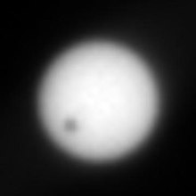

Mars: Transits of Deimos, Mercury
© Gerard Williger 2023, U Louisville
Deimos is much smaller and farther away, so it covers much less of the Sun
2 arcmin, 1/15th of Moon’s size from Earth
Observing transits of both moons helps refine their orbital parameters.
Transit of Mercury, from Mars, June 3, 2014.
-- 25 transits in 21st cent., vary 1-9 years apart
----- due to smaller synodic period, smaller inclination difference
2-frame VIDEO
Transit of Deimos, Mar 17, 2019, by NASA’s Curiosity rover. LINK shows 10” video loop, also
Phobos eclipse Mar 26, 2019, and
Phobos’ approaching shadow

Slide 34
Recent, Future Transits
© Gerard Williger 2023, U Louisville
Mercury:
RECENT: May 9, 2016; Nov 11, 2019
FUTURE:
Nov 13, 2032: W Asia, Central+E Europe, Africa; partial S America, W Europe, central Asia
Nov 7, 2039: Europe, Africa, W Asia, W Australia; partial western S America, central Asia, E Australia
May 7, 2049: Europe, Africa; end of transit in eastern N America
Venus:
RECENT: Jun 8, 2004; Jun 5-6, 2012
FUTURE:
Dec 10-11, 2117: E Asia, Australia; partial Africa, cent. Asia
Dec 8, 2125: Asia; partial Europe, western N America

Slide 35

Further Afield, from Mars
© Gerard Williger 2023, U Louisville
Transits of Mercury: Sep 5, 2024; Jan 26, 2034; Feb 21, 2035
Transit of Venus: Aug 19, 2030
Simultaneous Mercury+Venus transit: 18,713 AD, 19,536 AD, 20,029 AD LINK
Transit of Earth LINK: Nov 10, 2084
Moon usually transits, too
Subject of short story by A.C. Clarke, “Transit of Earth”, for May 11, 1984, published 1971
Simultaneous transit of Mercury+Venus from Earth: Jul 26, 69,163 AD LINK with 1’ video
Artist’s conception, transit of Earth+Moon from Mars, NASA/JPL, source LINK
Earth transits on average once per 73 yrs from Mars; per 11 years from Jupiter; per 8.8 years from Saturn; per 8.5 yrs from Uranus; per 7.5 yrs from Neptune; per 98 yrs from Pluto
Notes:
Short story was of doomed astronaut watching transit of Earth.

Slide 36
SUMMARY
© Gerard Williger 2023, U Louisville
Transits RARE, HARD to observe
Require precise predictions of planet, Sun positions
Only available since Kepler (1630)
Scientifically valuable
Timing for longitude determination
Variability of Earth’s rotation
Distance to Sun (→ size of solar system)
Confounded by Black Drop Effect
Planet sizes
Planet atmospheres
Since c. 2000, comparisons for exoplanet studies
Since 1874-82: in pop culture, events for public

